Slide 1
Improve medical performance and people’s health

Slide 2
THE PROBLEM
Actual Doctor-Patient Relationship
Health records not shared
Lack of digitalized Follow-up
The patient feels abandoned
No personalized clinical paths
2

Slide 3
OUR DIGITAL HEALTH ECOSYSTEM
Med58 developed a proprietary and comprehensive cloud-based platform and mobile App
Med58 serves: Patients, Doctors, Healthcare Facilities, Pharmaceutical and Insurance companies
CLINICAL VALUE
TELEHEALTH
BOOKING CARE
MEDICAL INTELLIGENCE

Slide 4
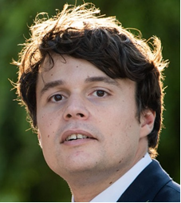
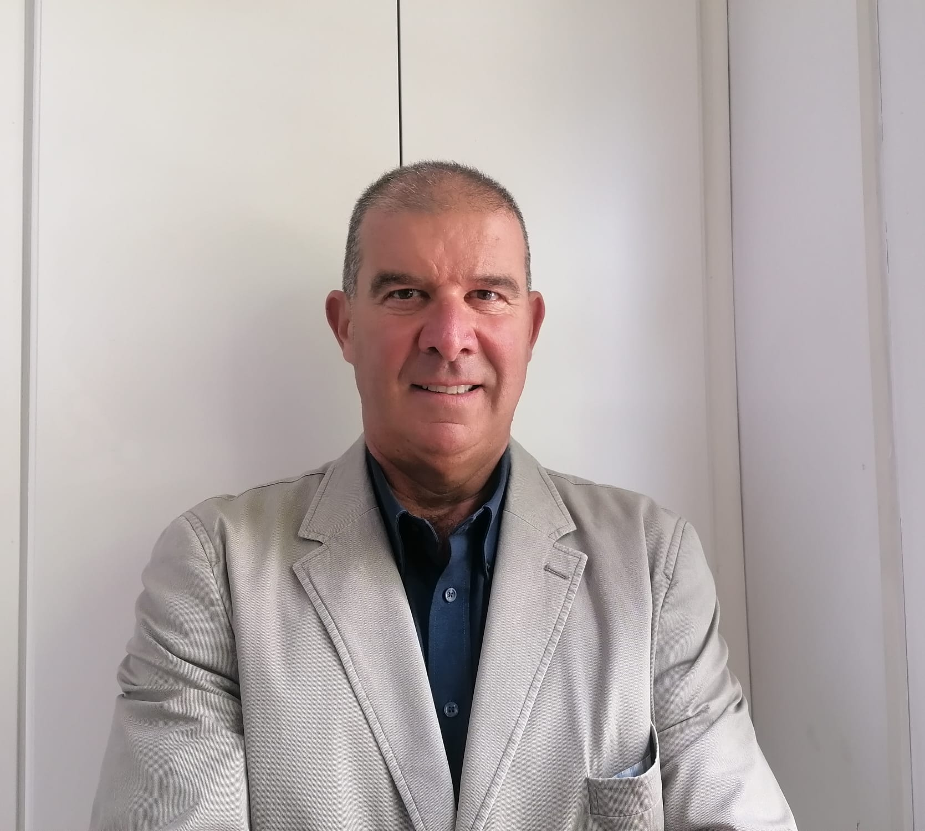
TEAM
A hands-on team with a deep market knowledge
Dott. Raffaele Nudi
Founder & CEO
Dott. Carlo Filangieri
Partner
Dott. Alessio Andreani
Chief Insurance & Welfare
Dott. Andrea Nudi
Founder & CIO
Dott. Francesco Nudi
Industry Expert
Prof. Paolo Boccardelli
Advisor
Prof. Luca Paolo Weltert
Chief Data Officer
Avv. Alberto Scirè
Data Protection Officer
Dott. Claudio Bruno
Advisor

Slide 5
SERVICE MODEL
MEDICAL SERVICE LIFECYCLE
PRE
ONGOING
POST
PROVISION
OF THE MEDICAL SERVICE
ANALYTICS & RISK MANAGEMENT
SHOWCASE
AGENDA
RESEARCH AND TRAINING
IN PRESENCE
MEDICAL DEVICE (IOT)
BOOKING
TELEHEALTH
TELEVISIT
2° OPINION
AI + NLP
PAYMENT
CLINICAL
PLAN
Data collection
past clinical data
Pre Medical Service
Survey
Structured
Data collection
Unstructured
Data collection
Survey post visita
Medical
Devices
Annual
Survey

Slide 6
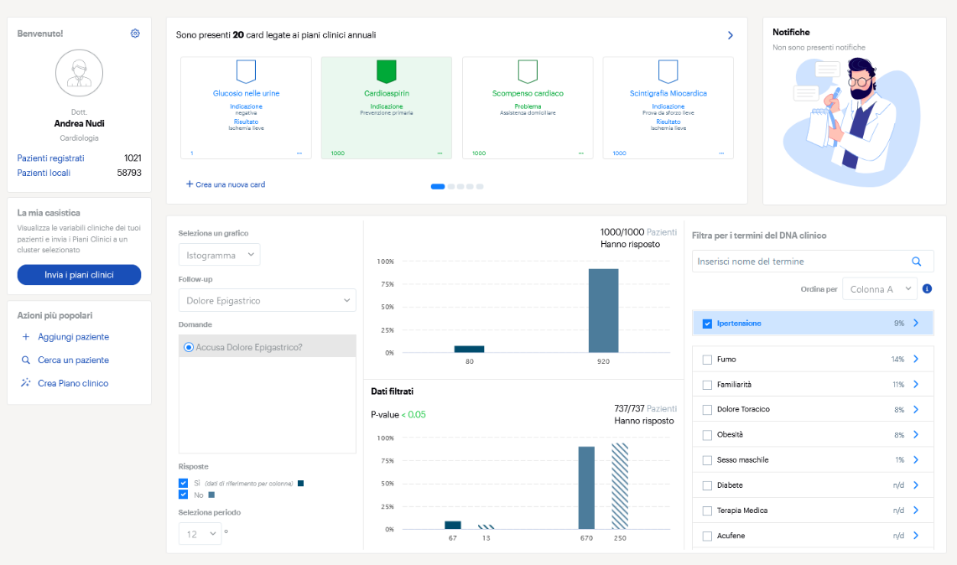
MED58 DASHBOARD SNAPSHOT

Slide 7
WHY MED58
Patients
Doctors
Companies
Continuity in monitoring
Real time sharing
Automatic alerts
Increase in number of patients
Quality and certification of the gathered data
Automatic alerts
Automated risks stratification
AI data interpretation
Home care support for chronic diseases

Slide 8
PARTNERS

Slide 9
CLIENTS

Slide 10
DIGITAL HEALTH MARKET
PRE- COVID
POST- COVID
9%
CAGR 2019-2026
33,4%
CAGR 2020-2027
51,4
€ Bil. year 2020
217,1
€ Bil. year 2022
€1,8
Bil.
€15
Bil.
€912
Bil.
Italian Digital Health Expenditure 2022(+7% YoY)
PNRR - total allocated to Healthcare in Italy
2032 Estimate global market size
10

Slide 11
B2B SaaS MODEL
Healthcare
Insurance &
Welfare
Pharmaceutical
Companies
Revenue Sharing
Insurance Policy Integration
Real World Evidence

Slide 12
MED58 FINANCIALS AND KPI
2022
2023
€ 700k
€ 179k
244
800
6.546.320
20.000.000
126.533
500.000

Slide 13
GROWTH STRATEGY
Open pre Series A of 1.5M (free + allocated)
Investment
€1 M
Free to be allocated
€ 1.5M
+ €500k
Already committed
13

Slide 14
CONCLUSIONS
THANK YOU
KEEP IN TOUCH
Raffaele
Andrea

